Slide 1

Problem
Description
Given the clinical parameters
about the patients,
Can we predict whether
or not they have heart disease
in 10 Years
HEART DISEASE PREDICTION
USING MACHINE LEARNING
Problem
Description
Methodology
& Algorithms
ML Analysis
Results
Conclusion
Prepared by (Team 1)
Aida Ndiongue
Christopher Sharber
Rocky Owens
Alexandr Gorbulin
Mission
Heart disease is the leading cause of death
for men, women, and people of most racial and
ethnic groups in the United States.
One person dies every 33 seconds
in the United States from cardiovascular disease.
About 695,000 people in the United States
died from heart disease in 2021—that’s 1 in every 5 deaths.
Heart disease cost the United States
about $239.9 billion each year from 2018 to 2019.
This includes the cost of health care
services, medicines, and lost productivity due to death.

Slide 2
Problem
Description
Methodology
& Algorithms
HEART DISEASE PREDICTION
USING MACHINE LEARNING
ML Analysis
Results
Problem
Description
Given the clinical parameters
about the patients,
Can we predict whether
or not they have heart disease
in 10 Years
Conclusion
Mission
Heart disease is the leading cause of death
for men, women, and people of most racial and
ethnic groups in the United States.
One person dies every 33 seconds
in the United States from cardiovascular disease.
About 695,000 people in the United States
died from heart disease in 2021—that’s 1 in every 5 deaths.
Heart disease cost the United States
about $239.9 billion each year from 2018 to 2019.
This includes the cost of health care
services, medicines, and lost productivity due to death.
Prepared by (Team 1)
Aida Ndiongue
Christopher Sharber
Rocky Owens
Alexandr Gorbulin

Slide 3
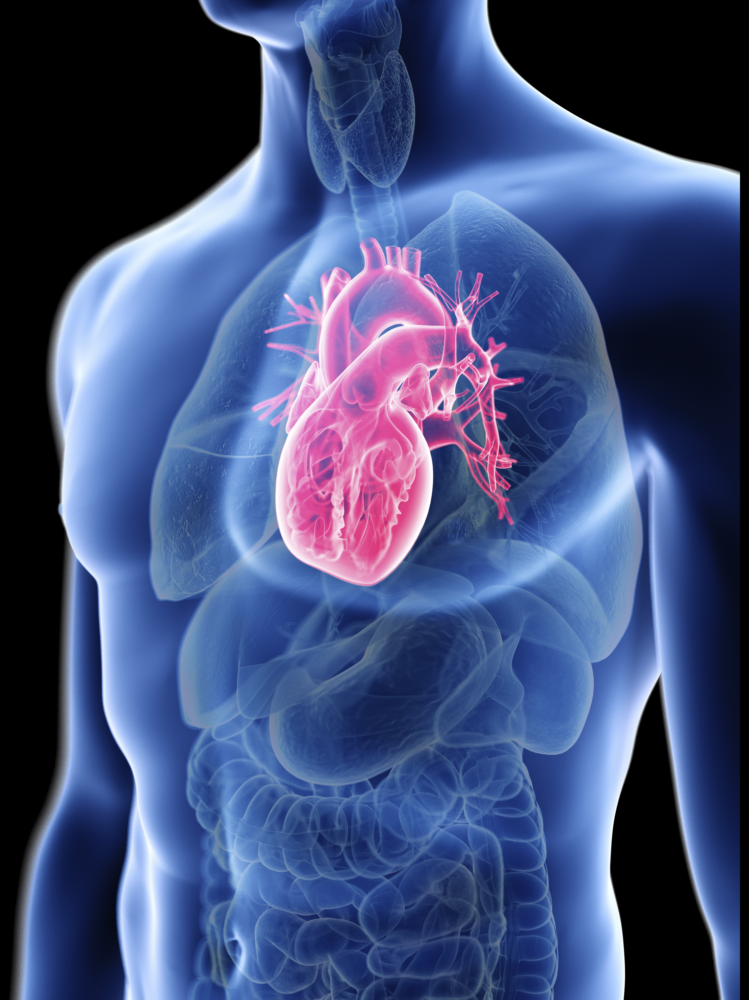
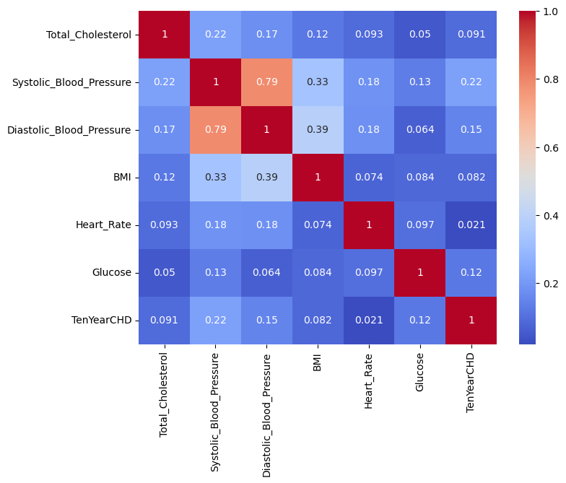
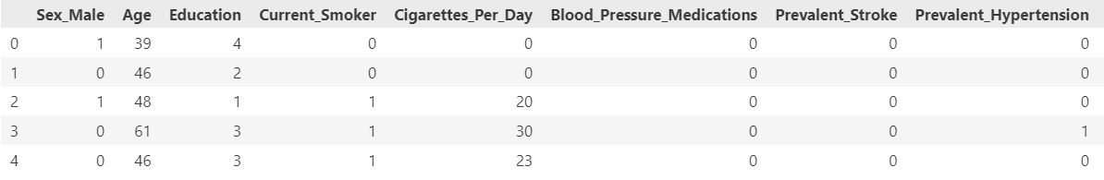
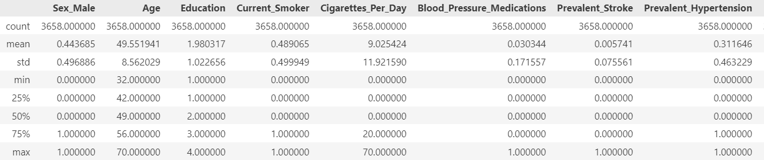
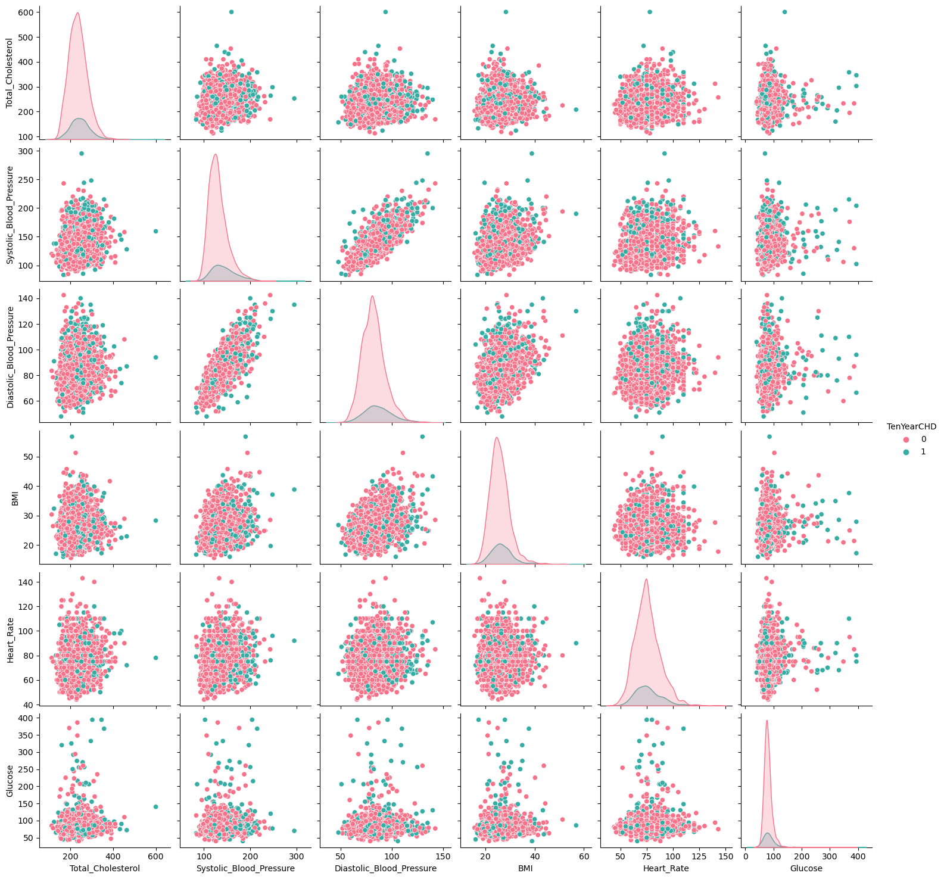
Original Data Set & ETL

Slide 4
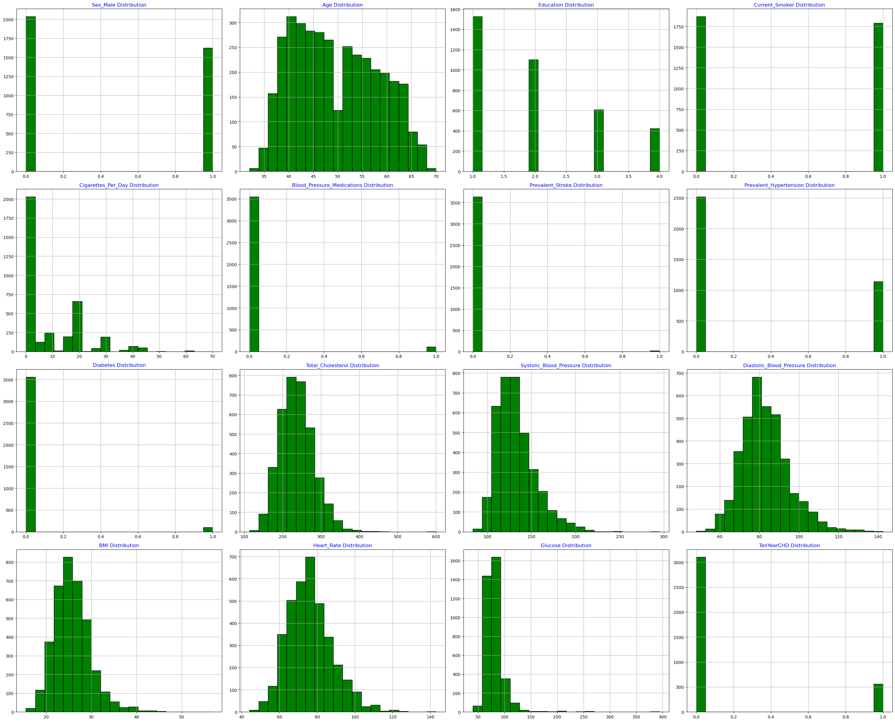
Methodology
Algorithms
Explore
Supervised Methods to
find any particular patterns
Preliminary Data Visualization
Machine Learning Algorithms:
PCA Method
Decision Tree Model
Random Forest
KNeighbors Model
Keras Neural Network
Notes:
A seaborn pairplot (sns pairplot) is a useful visualization tool for exploring relationships between multiple variables in a dataset. It creates a grid of scatterplots and histograms, allowing you to examine pairwise relationships and distributions simultaneously. Here are some critical pieces of information that can be obtained from a pairplot:
Correlation: Pairplots provide a quick way to assess the linear relationships between variables. By observing the scatterplots, you can identify positive or negative correlations between pairs of variables. If the scatterplot shows a clear pattern or trend, it suggests a strong relationship between the variables.
Distribution: Pairplots also display histograms along the diagonal of the grid. These histograms allow you to visualize the distribution of each variable individually. You can identify whether the variables follow a normal distribution or if they have skewness or outliers.
Outliers: Outliers can be detected in scatterplots as points that are significantly distant from the main cluster of points. Pairplots help in identifying these outliers and understanding their impact on the relationship between variables.
Clustering: If there are distinct clusters or groups in the data, pairplots can reveal them. Clusters can appear as dense areas or separate scatterplot groups, indicating potential patterns or subgroups within the dataset.
Multicollinearity: Pairplots are particularly useful for identifying multicollinearity, which occurs when two or more variables are highly correlated. If two variables have a strong linear relationship, it suggests that they provide similar information, potentially leading to redundancy or instability in the model.
Variable importance: Pairplots help in determining the relevance and importance of variables for predicting a target variable. By examining the scatterplots against the target variable, you can identify variables that exhibit a clear relationship or have predictive power.
Data quality issues: Pairplots can also reveal data quality issues, such as missing values or inconsistent scaling, which may be indicated by unusual patterns or gaps in scatterplots.
Overall, sns pairplot provides a comprehensive visual exploration of the relationships and distributions between variables in a dataset. It helps in gaining insights, identifying patterns, and making informed decisions about feature selection, data preprocessing, and model building.

Slide 5
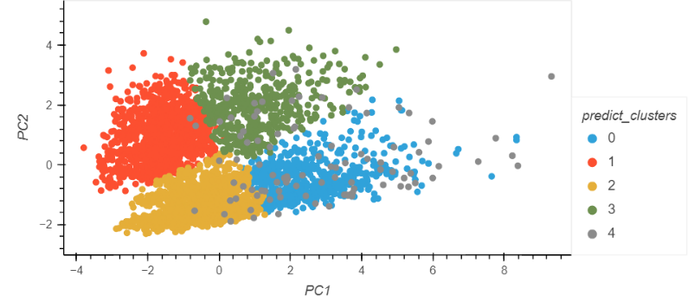
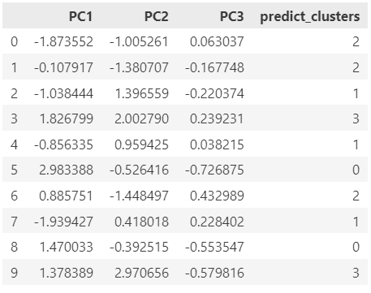
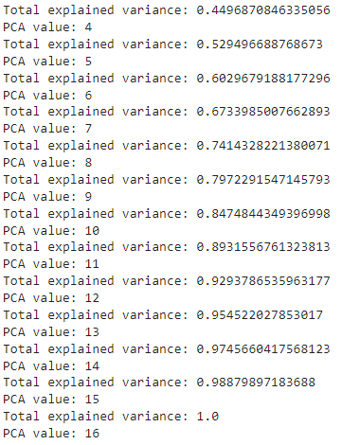
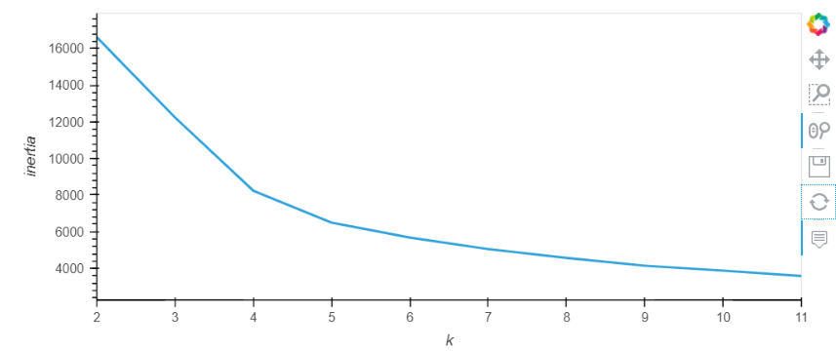
Problem
Description
Methodology
& Algorithms
HEART DISEASE PREDICTION
USING MACHINE LEARNING
Methodology
Algorithms
Explore
Supervised Methods to
find any particular patterns
ML Analysis
Results
Conclusion
Machine Learning Algorithms:
PCA Method
Decision Tree Model
Random Forest
KNeighbors Model
Keras Neural Network
Prepared by (Team 1)
Aida Ndiongue
Christopher Sharber
Rocky Owens
Alexandr Gorbulin

Slide 6
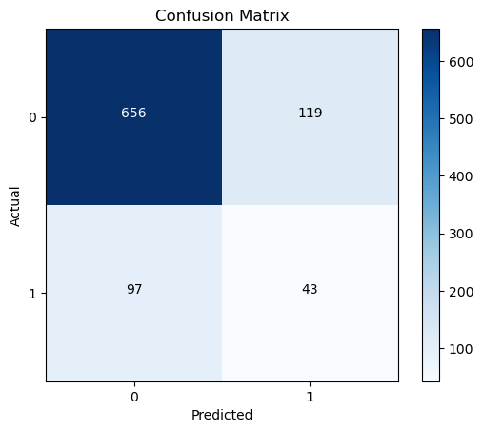
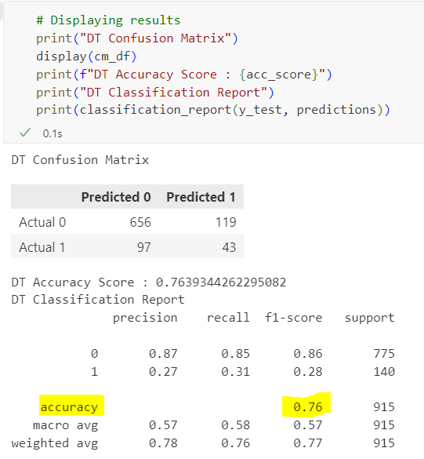
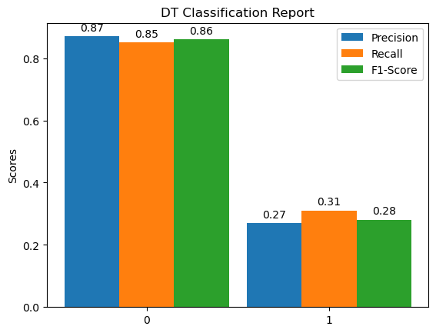
Supervised Methods – Decision Tree Model
Notes:
The rows represent the actual class labels, while the columns represent the predicted class labels. Each cell in the confusion matrix represents the count of observations that fall into a particular category.
The top-left cell (656) represents the number of observations that were actually labeled as 0 and correctly predicted as 0.
The top-right cell (119) represents the number of observations that were actually labeled as 0 but incorrectly predicted as 1.
The bottom-left cell (97) represents the number of observations that were actually labeled as 1 but incorrectly predicted as 0.
The bottom-right cell (43) represents the number of observations that were actually labeled as 1 and correctly predicted as 1.
From this confusion matrix, we can extract several evaluation metrics:
Accuracy: The accuracy score indicates the overall correctness of the model's predictions. In this case, the accuracy score is 0.7639, meaning that the model correctly predicted the class label for approximately 76.39% of the observations.
The classification report provides additional evaluation metrics for each class (0 and 1):
Precision: Precision measures the proportion of true positive predictions out of all positive predictions. For class 0, the precision is 0.87, indicating that 87% of the observations predicted as class 0 were actually labeled as class 0. For class 1, the precision is 0.27, indicating that only 27% of the observations predicted as class 1 were actually labeled as class 1.
Recall: Recall, also known as sensitivity or true positive rate, measures the proportion of true positive predictions out of all actual positive observations. For class 0, the recall is 0.85, indicating that the model correctly identified 85% of the observations labeled as class 0. For class 1, the recall is 0.31, indicating that the model correctly identified only 31% of the observations labeled as class 1.
F1-score: The F1-score is the harmonic mean of precision and recall, providing a balanced measure of the model's performance. For class 0, the F1-score is 0.86, and for class 1, the F1-score is 0.28.
The support column in the classification report represents the number of observations in each class.
The macro average (macro avg) and weighted average (weighted avg) provide overall evaluation metrics, taking into account the class imbalance. The macro avg calculates the unweighted mean of precision, recall, and F1-score, giving equal importance to each class. The weighted avg calculates the weighted mean of precision, recall, and F1-score, considering the number of observations in each class.
In summary, the confusion matrix and classification report provide insights into the model's performance, including the accuracy, precision, recall, and F1-score for each class, as well as overall evaluation metrics.

Slide 7
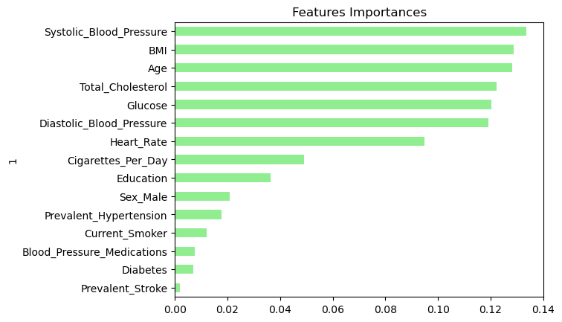
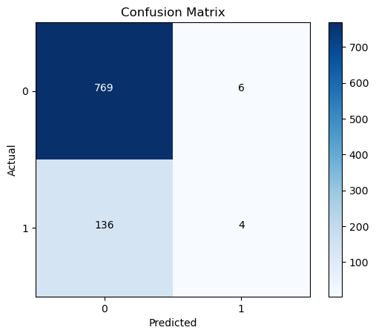
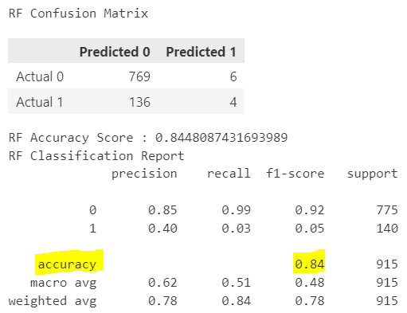
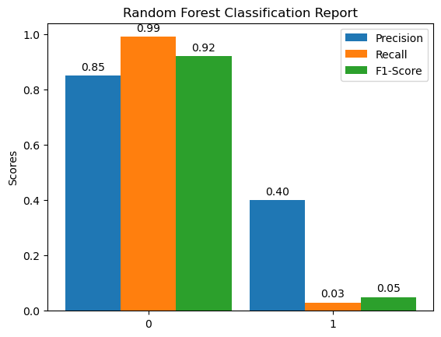
Supervised Methods – Random Forest Model

Slide 8

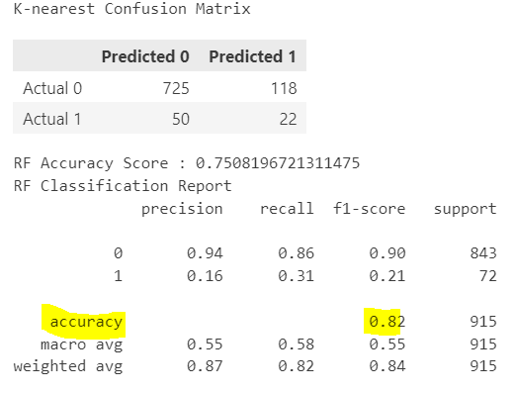
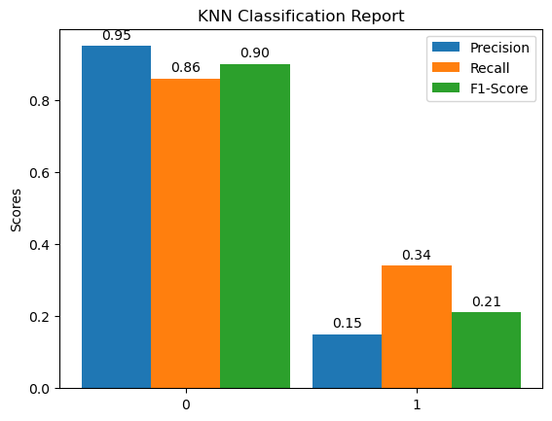
Supervised Methods – KNN Model

Slide 9
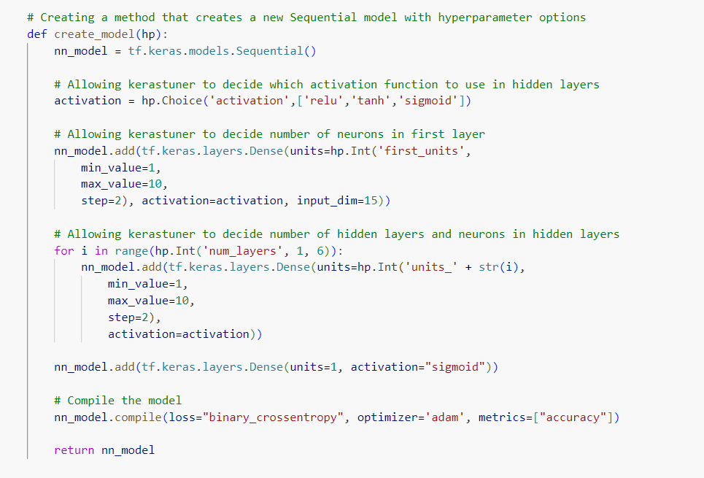
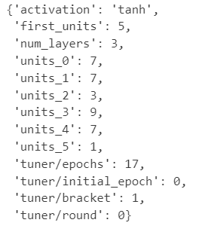
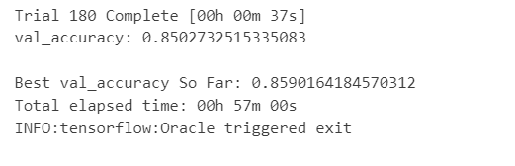
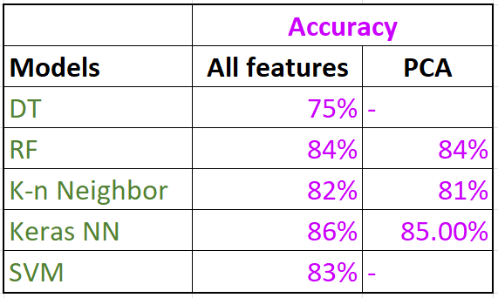
Results
Supervised Methods – Keras NN Model
Notes:
activation: The activation function used in the hidden layers of the neural network. In this case, the "tanh" function is used. The hyperbolic tangent (tanh) function is a common activation function that squashes the input values between -1 and 1.
first_units: The number of units (neurons) in the first hidden layer of the neural network. In this case, there are 5 units in the first layer.
num_layers: The total number of hidden layers in the neural network. In this case, there are 3 hidden layers (excluding the input and output layers).
units_0, units_1, units_2, units_3, units_4, units_5: The number of units (neurons) in each hidden layer of the neural network. In this case, there are 7 units in the first and second layers, 3 units in the third layer, 9 units in the fourth layer, and 7 units in the fifth layer. The units_5 represents the output layer, which has 1 unit.
tuner/epochs: The total number of epochs (training iterations) for the neural network model. In this case, the model will be trained for 17 epochs.
tuner/initial_epoch: The initial epoch of the training process. In this case, the initial epoch is set to 0.
tuner/bracket: The bracket number used in hyperparameter tuning. It is used by some hyperparameter optimization algorithms to determine the number of models to train at each iteration.
tuner/round: The round number used in hyperparameter tuning. It indicates the current round of hyperparameter optimization.

Slide 10
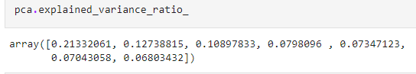
PCA Method
Notes:
The table you provided represents the results of a Principal Component Analysis (PCA) on a dataset. PCA is a dimensionality reduction technique used to transform a high-dimensional dataset into a lower-dimensional space while preserving the most important information.
In the given table:
PC1, PC2, and PC3 are the principal components obtained from the PCA. These components are linear combinations of the original features in the dataset and are sorted in descending order of explained variance. PC1 represents the most significant component, PC2 represents the second most significant component, and so on. Each row in the table corresponds to an observation (or data point), and the columns PC1, PC2, and PC3 represent the values of the respective principal components for each observation.
The predict_clusters column indicates the predicted clusters assigned to each observation based on the PCA results. It seems that the PCA was used to cluster the observations into four groups, labeled as 0, 1, 2, and 3. Each row in the table specifies the assigned cluster label for the corresponding observation.
To interpret the table and the PCA results:
The values in the PC1, PC2, and PC3 columns represent the coordinates of each observation in the reduced-dimensional space. These values indicate the contribution of each principal component to the representation of the observation.
The relative magnitudes of the values in the PC1, PC2, and PC3 columns provide insights into the importance of each component for describing the data. Larger values indicate a stronger influence of the corresponding principal component on the data point.
The predict_clusters column shows the assigned clusters for each observation based on the PCA results. The clustering algorithm likely used the values of the principal components to determine the similarity between observations and group them accordingly.
Overall, PCA helps to simplify the representation of the dataset by reducing its dimensionality while preserving important patterns and information. The table you provided displays the transformed data points in the reduced-dimensional space and their assigned clusters based on the PCA results.

Slide 11

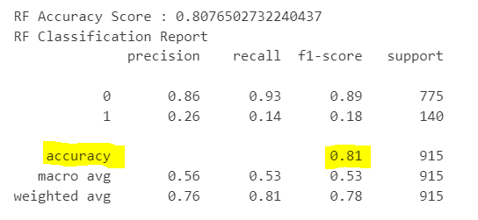
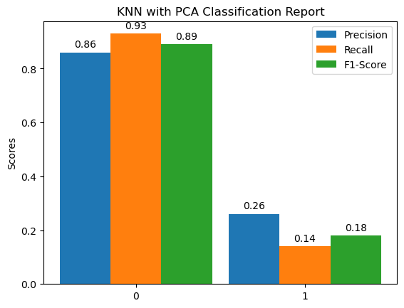
Supervised Methods – KNN with PCA Model

Slide 12
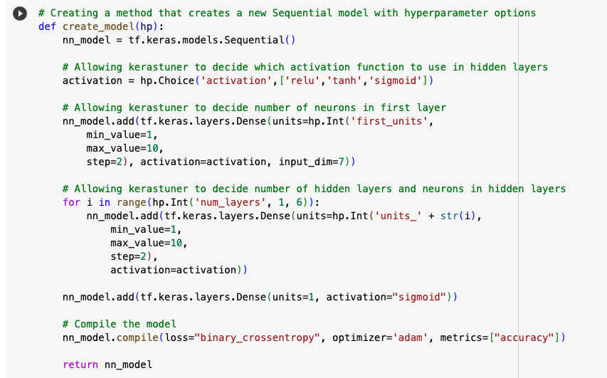

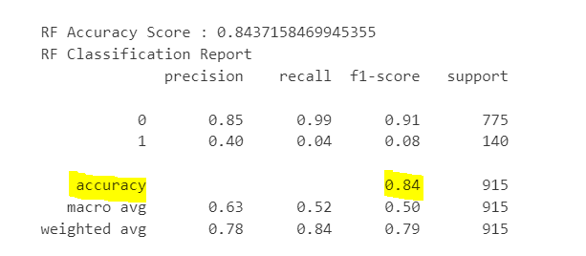
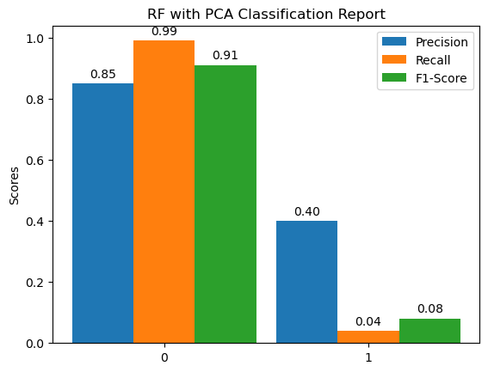
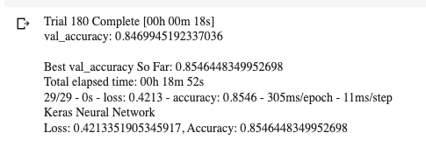
Supervised Methods – RF with PCA Model

Slide 13
Supervised Methods – Keras NN with PCA

Slide 14
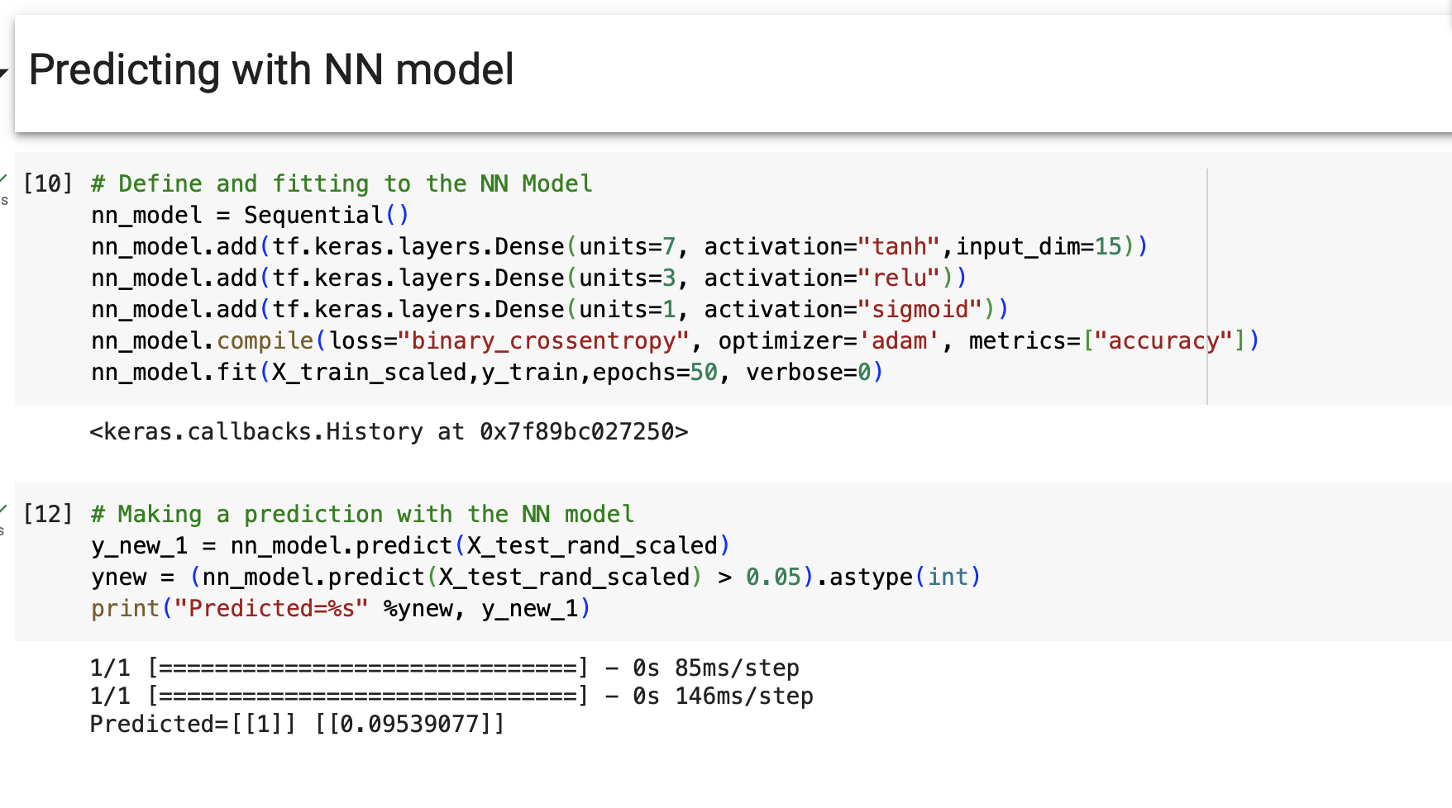
Deployment with Keras NN

Slide 15
Conclusion
Use of ML predictions can help with
Improved accuracy
Early Detection
Feature selection
Provide decision support
Problem
Description
Methodology
& Algorithms
HEART DISEASE PREDICTION
USING MACHINE LEARNING
Results
ML Analysis
Results
Conclusion

Slide 16
Problem
Description
Methodology
& Algorithms
HEART DISEASE PREDICTION
USING MACHINE LEARNING
Conclusion
Use of ML predictions can help with
Improved accuracy
Early Detection
Feature selection
Provide decision support
ML Analysis
Results
Conclusion
Prepared by (Team 1)
Aida Ndiongue
Christopher Sharber
Rocky Owens
Alexandr Gorbulin

